Slide 1


Zomato Analysis
Group - 5

Slide 2

Business Overview
Zomato is a leading restaurant search and discovery service, providing in-depth information about dining places, online ordering, and food delivery across many countries. It has revolutionized the way people decide what to eat.

Slide 3

Introduction to Zomato
1
Global Presence
2
User-Friendly Interface
Zomato operates in multiple countries, making it a diverse and far-reaching platform for restaurant discovery.
Zomato offers a user-friendly interface, providing an easy means to explore and discover new dining experiences.
3
Community Engagement
It has a strong community of food enthusiasts, contributing reviews, ratings, and photos of their dining experiences.

Slide 4

Market position and competition
Market Position
Competitors
Zomato has established itself as a key player in the food delivery and restaurant discovery industry.
It competes with various local and international businesses, creating a dynamic marketplace for food service.

Slide 5

Revenue streams and business model
1B+
Multiple
Valuation
Revenue Streams
Zomato generates revenue through online food delivery services, restaurant advertising, and premium subscription models.

Slide 6

Project Scope
1
Scope
The scope of this data analysis project encompasses understanding user preferences, exploring restaurant trends, and identifying patterns that can inform strategic decisions.
2
Key Objectives
The key objectives include evaluating restaurant ratings, analyzing cuisine preferences, and providing actionable insights for Zomato.

Slide 7

Data Model Challenges
Complex Data Sources
Data Quality Issues
Aggregating data from multiple sources and formats presents a significant challenge for the data model.
Data quality issues like inconsistencies and missing values, required careful handling.
Scalability and Performance
Ensuring a balance between complexity and simplicity was crucial to creating a model that could accommodate the diverse data points within the Zomato dataset.

Slide 8

Data collection and integration
2M+
Global
Data Points
Data Integration
Zomato collects and processes millions of data points related to restaurants and consumer behavior.
Integrating data from diverse sources allows for a comprehensive view of the food industry on a global scale.

Slide 9
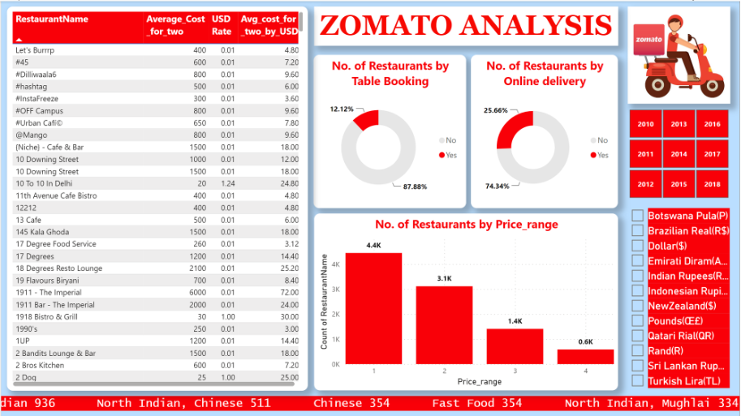
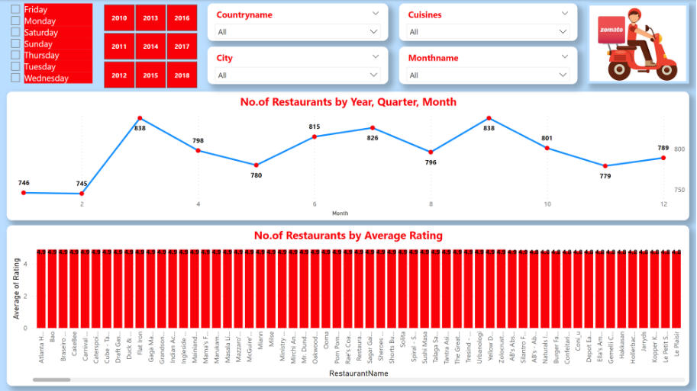
Dashboard Overview

Slide 10

Suggestions to the Company
Based on the analysis we have done; several actionable suggestions emerge. These include -
Refining the recommendation algorithm.
Addressing areas with lower user satisfaction and taking necessary actions.
Exploring partnerships with popular cuisines to enhance the platform's appeal.
Strategic implementation of these recommendations can contribute to Zomato's continued success.

Slide 11

Conclusion
This data analysis project provides valuable insights into Zomato's dynamics, shedding light on user preferences and industry trends. The findings aim to empower Zomato with actionable intelligence for strategic decision-making, ensuring the platform remains a leader in the dynamic food industry.

Slide 12
THANK YOU

